Slide 1
WHAT IS TENDER?
Tender is :
an offer to contractor to do the work for a certain amount of money
incorporate time and other conditions required
to carry out the contract requirements
main reason is to complete a project
The tender which is submitted by the contractor is generally based on a bill of quantities & specifications of the statement of work.

Slide 2
Difference between
TENDER & CONTRACT
TENDER
The term tender formally means an invitation to trade under the terms of offer.
CONTRACT
A contract is the term used when 2 parties have reached agreement.

Slide 3
TENDER SYSTEM
The process of finalization of contracts is achieved through the tender process.
Advantages of the Tender process
Most effective method of locking competitive rates.
New technologies and options are received through open tender process.

Slide 4
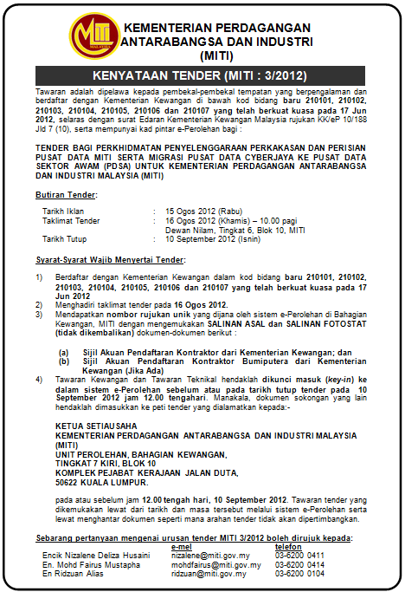
TENDER NOTICE
The Tender Notice is a brief description of the job being tendered
to be published in Newspapers and on the Internet.
The Internet is a very cost effective way of publishing the tenders.

Slide 5
Format of an ideal tender notice
Name of the Project.
Name & Address of the Company offering the tender.
Name of work, materials or services.
Place of work location.
Approximate estimated cost of work.
Earnest Money.
Period of completion.
Date on which the Tender Document sale commences.
Date and time up to which tender documents can be obtained.
The cost of tender documents.
Due date of submission
Eligibility Criteria

Slide 6
TYPES OF TENDER
Open tender (tawaran terbuka)
Close tender (tawaran terhad) / Selective tender (tawaran terpilih)
Negotiated tender (tawaran perundingan)

Slide 7
Open tender
Bidding process that is open to all qualified bidders
Tender usually published in the newspaper and internet
chosen on the basis of price and quality.
This is most effective way of obtaining many competitive rates.

Slide 8
Open tender - advantages
Any contractor can tender their work
No favoritism occurred
maximum competition
No commitment( terikat) to tender, all tender received will be genuine.

Slide 9
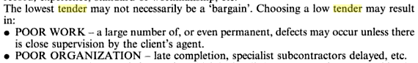
Open tender - disadvantages
Client must bear expensive cost of tendering ( reproducing number of dwgs, bq etc.
The wrong contractor may be chosen because they are from unknown background
Time consuming

Slide 10
Limited / selective tender
Limited tender
  Tender open to bidders in the category stated in the notice only.
  Example: limited tender is for Bumiputra bidders only.
Selective tender
  A number of contractor of known reputations are selected by the design team to submit a price of the project.
  The contractor who submit the lowest tender is generally awarded the contract.
  The number chosen to bid under this tender is little
  they are chosen for their expertise and experiences

Slide 11
Negotiated tender
Under this method, only one contractor is approached
normally because the skills of the contractor are such that the architect and other members of the design team needed from the contractor’s specialist knowledge use for design stage
Following the completion of the design, the contractor will price the bill of quantities and then enter into a negotiation with the quantity surveyor.

Slide 12
Tender process
iklan tawaran ( tender notice)
jemputan tawaran (tender invitation)
pemilihan tawaran (tender selection)
penerimaan tawaran (tender award)

